Slide 1
2025-26 YMTR – Plays 22-24: Screening
TJ Halliday – Director of Learning and Development, IAABO, Inc.
Notes:
Lesson 1

Slide 2
2025-26 YMTR
Welcome to the 2025-26 basketball season. On behalf of Donnie Eppley, Executive Director of IAABO, the International Association of Approved Basketball Officials.
It is our pleasure to highlight areas that need attention as we approach the new season. These areas include:
Block/charge
Traveling
Contact on ball handlers
Offense-initiated contact
Post play
Rebounding contact
Screening
Violations

Slide 3
2025-26 YMTR
We will comment on proper signaling and floor mechanics as each play is reviewed, in addition to discussing the application of the rules. We are asking all officials to commit to utilizing accurate signals when making rulings in their games. Let’s remember where we are each night when we enter the court. If we are officiating a high school game, then we should use the approved high school signals and floor mechanics and set an example for all high school officials to follow. These signals and floor mechanics are listed in the officials’ manual, along with the procedures for ruling fouls, violations, time-outs, etc.

Slide 4
2025-26 YMTR
See if you can make correct rulings on these plays. This presentation is designed to create lively discussions and assist in officiating these plays correctly. We would like to thank the officials shown in these clips as they are providing a great service in teaching these concepts to our members. Many thanks also to President Don Thorne and the IAABO Executive Committee for making this presentation possible.

Slide 5
SUPPORT
If you should have any questions, comments, feedback about this material, please contact TJ Halliday at tjhalliday@iaabo.org.

Slide 6
FORMAT
This presentation is created to create an interactive session either in person or in an online session like Zoom, Teams, Google Meet, etc.
Each play begins with a question posed to the audience to prepare them for the situation they will encounter.
The audience will be shown a video clip.
The facilitator with then lead the group in discussion about the ruling and attempt to arrive at a consensus for the correct ruling.
Once the audience determines their answer, we will provide the official answer along with a play summary that outlines the specific rules and manual information that applies to each situation.

Slide 7
FORMAT
There are a handful of “You Make Ruling” plays where IAABO does not provide an official answer. We still provide a play summary for the facilitator to address the rules, floor mechanics, procedures and signals that apply.
**** This year, all 40 of the clips feature Crew of 2 floor mechanics.

Slide 8
SCREENING

Slide 9
PLAY #22

Slide 10
PLAY # 22
Was this properly ruled a team-control foul for an illegal screen?
  Yes
  No

Slide 11
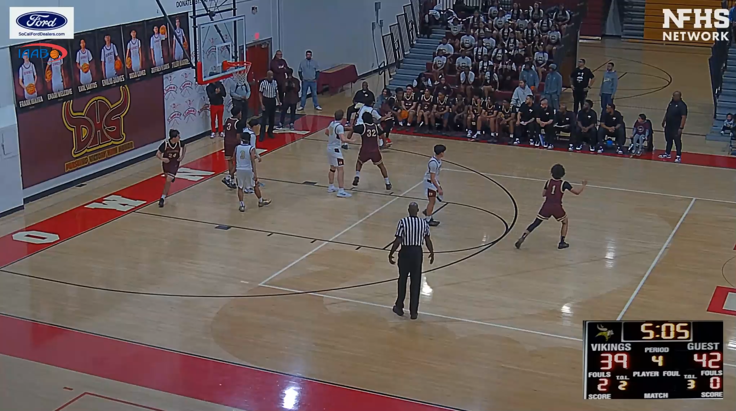
SCREEN

Slide 12
PLAY # 22
Was this properly ruled a team-control foul for an illegal screen?
  Yes
  No

Slide 13
PLAY # 22
Was this properly ruled a team-control foul for an illegal screen?
  Yes
  No

Slide 14
PLAY SUMMARY
In this play, the player is attempting to screen a moving opponent.
In situations such as this, the screener must allow the person being screened sufficient time and distance to stop and change direction.
When a screener sets a screen on a moving opponent, they must take into account the speed of the player they are screening. Depending on how quickly the opponent is moving, the screener will need to set the screen one to two normal strides from the opponent.
IRG 10:6, NFHS 4-40

Slide 15
PLAY #23

Slide 16
PLAY # 23
Was this properly ruled a team-control foul for an illegal screen?
  Yes
  No

Slide 17
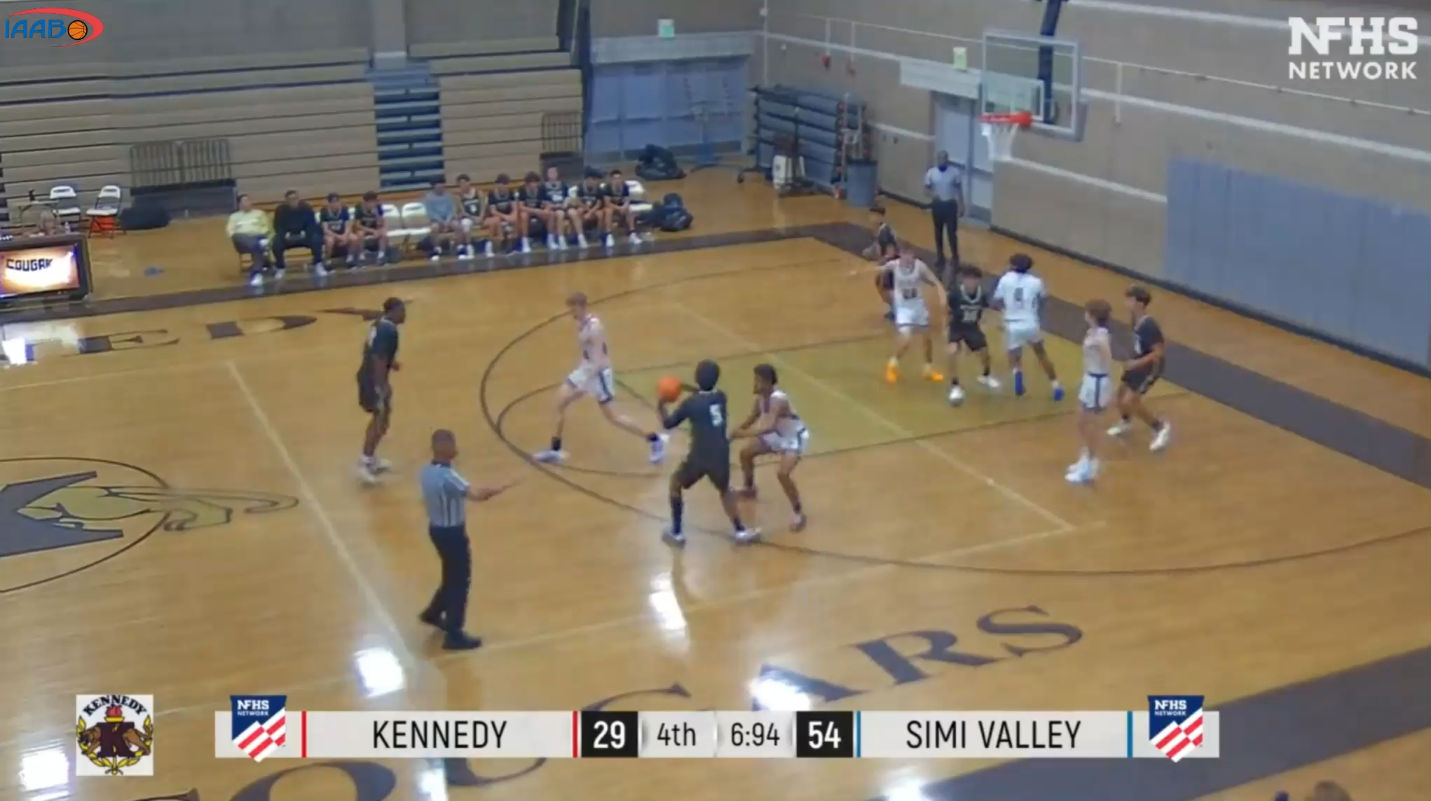
team-control foul RULED

Slide 18
PLAY # 23
Was this properly ruled a team-control foul for an illegal screen?
  Yes
  No

Slide 19
PLAY # 23
Was this properly ruled a team-control foul for an illegal screen?
  Yes
  No

Slide 20
PLAY SUMMARY
The contact was not that significant on this play. However, the severity of the contact is not the determining factor in this play. Officials just need to assess the contact inhibited the freedom of movement of the player being screened.
This contact can be the difference between the ball handler getting an “open” shot versus a “contested” shot.
In this situation, the screener did not allow the person being screened sufficient time and distance to stop and change direction and a team-control foul was correctly assessed.
IRG 10:6, NFHS 4-40

Slide 21
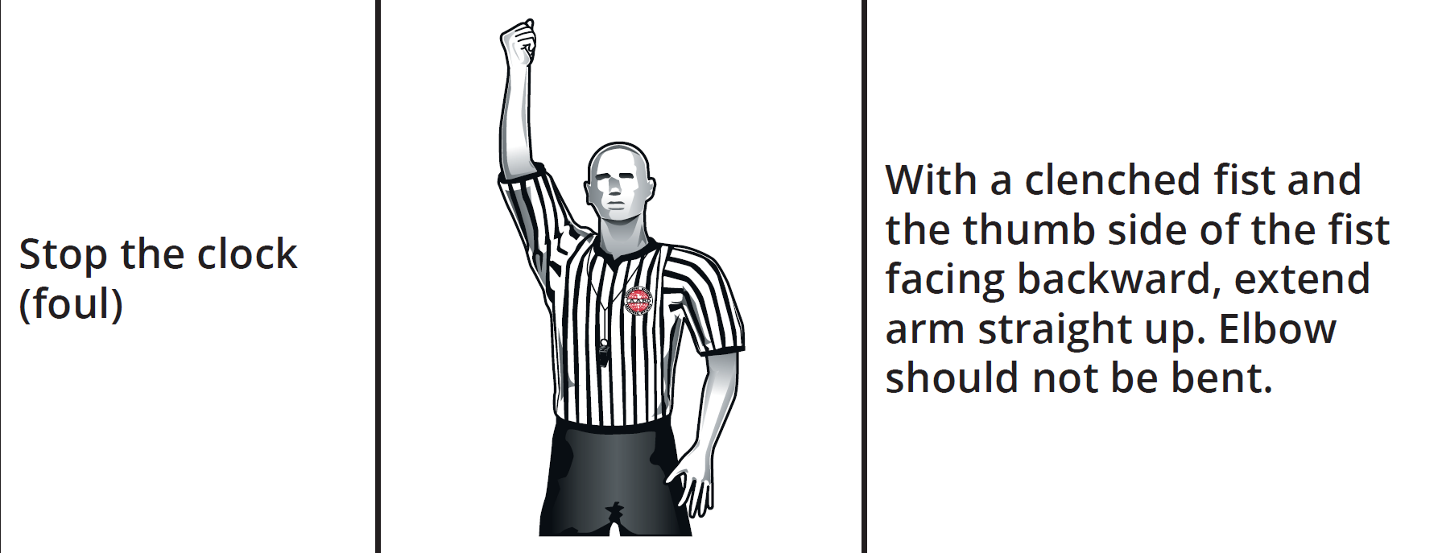
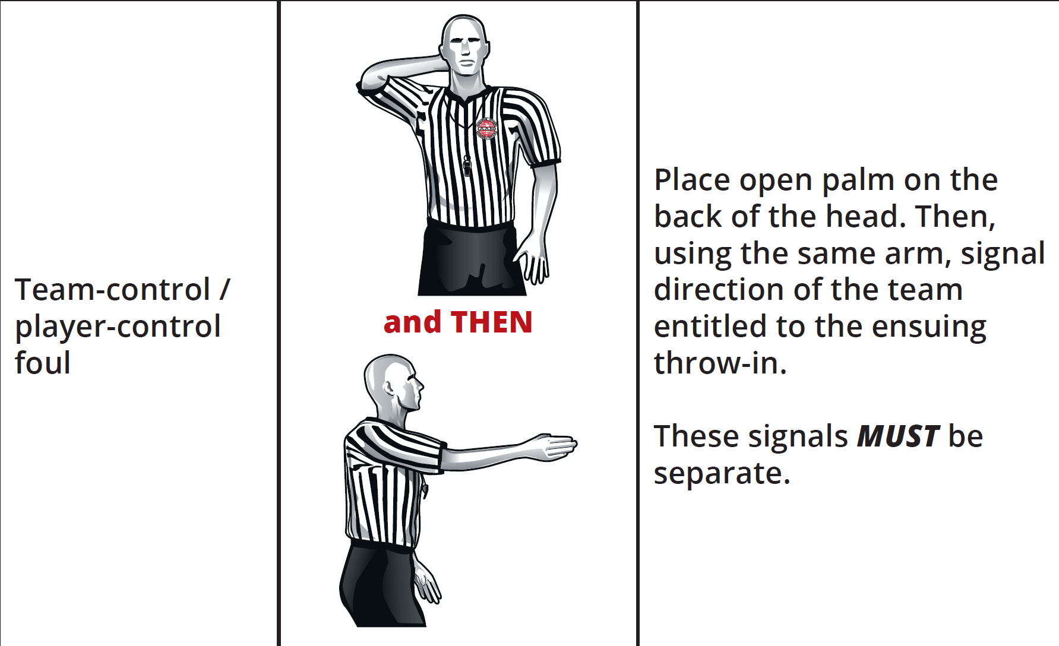
SIGNALS REVIEW
The official did not display the stop-the-clock-foul signal, nor the appropriate team-control foul signal.
The player (and team) control signal is done in two distinct steps.
  Drop the stop-the clock signal and place that same hand behind the head.
  Then signal direction of the team being awarded the ball for a throw-in.
IAABO Manual 13:1, 19:2

Slide 22
REPORTING FOULS
The official in this clip reported the foul just a few steps from the end line, then returned to the end line to administer the ensuing throw-in.
Officials should hustle to the reporting area, moving briskly around all players while observing the bench areas.
Officials should then switch positions after the report.
IAABO Manual 13:2

Slide 23
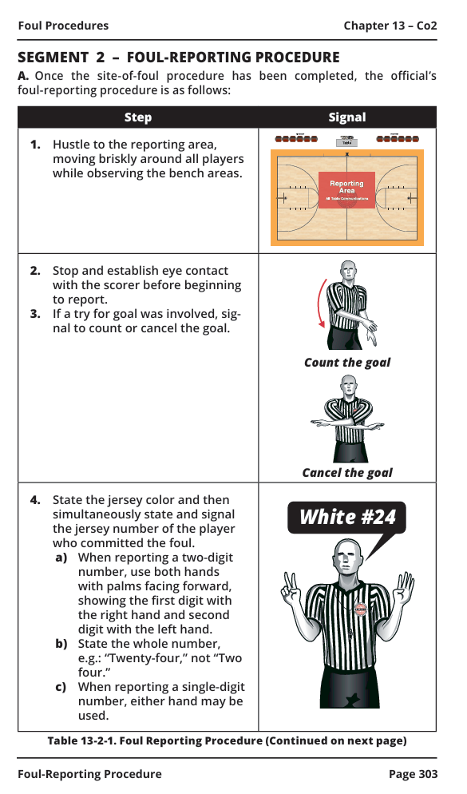
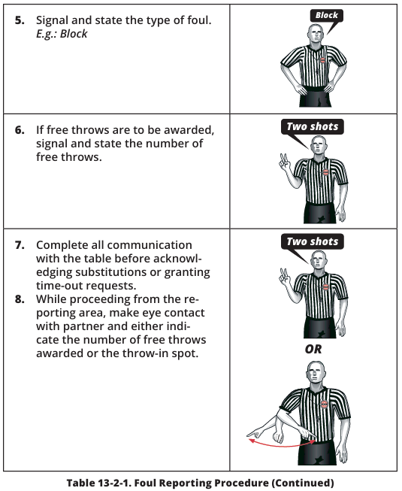
REPORTING FOULS
The correct procedure for reporting a foul is as follows:
IAABO Manual 13:2

Slide 24
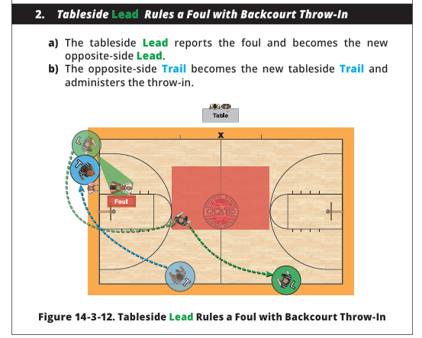
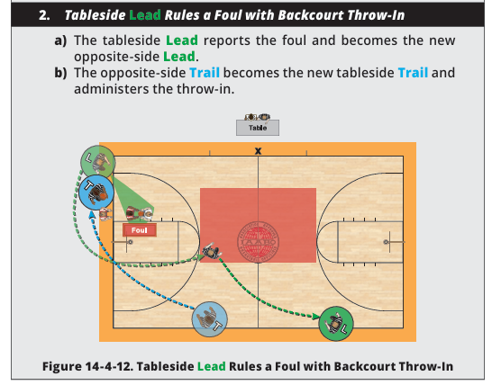
SWITCH
In both IAABO and NFHS Manuals, a switch is required after this foul. Here is the switch in both tableside and opposite side mechanics:
Tableside Mechanics
Opposite Side Mechanics
IAABO Manual Figure 14-3-12

Slide 25
PLAY #24

Slide 26
PLAY # 24
Was this properly ruled to be a team-control foul for an illegal screen?
  Yes
  No

Slide 27
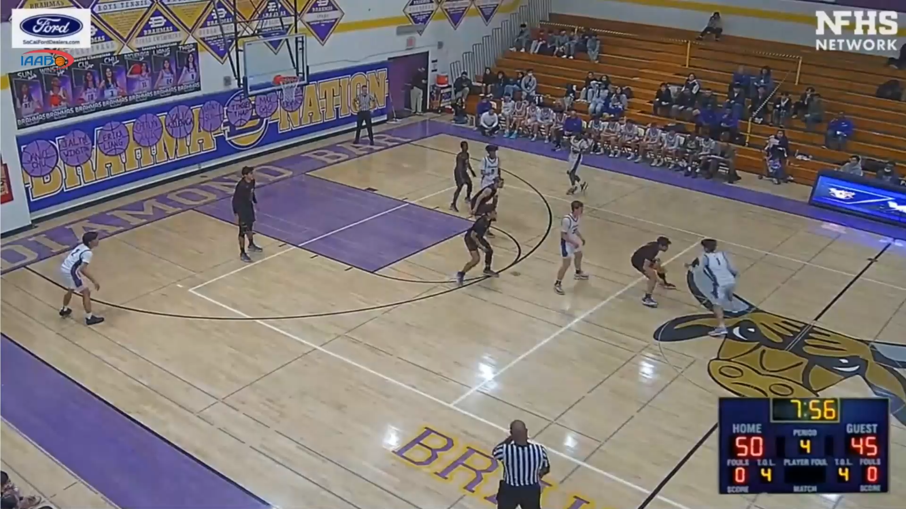
team-control foul RULED

Slide 28
PLAY # 24
Was this properly ruled to be a team-control foul for an illegal screen?
  Yes
  No

Slide 29
PLAY # 24
Was this properly ruled to be a team-control foul for an illegal screen?
  Yes
  No

Slide 30
PLAY SUMMARY
In this situation, the screener did not allow the person being screened sufficient time and distance to stop and change direction, and a team-control foul was correctly assessed.
This contact resulted in a significant advantage as it allowed the dribbler to move past the primary defender.
When a screener sets a screen on a moving opponent, they must take into account the speed of the player they are screening. Depending on how quickly the opponent is moving, the screener will need to set the screen one to two normal strides from the opponent.
IRG 10:6, NFHS 4-40

Slide 31
SITE-OF-FOUL,
Site of-VIOLATION,
and HELD-BALL PROCEDURES

Slide 32
SITE-OF-FOUL, Site of-VIOLATION, and HELD-BALL PROCEDURES
Many of the plays seen in this video do not feature proper site procedures.
This section can be utilized by clinicians to educate officials what the proper procedures should look like when executed properly.

Slide 33
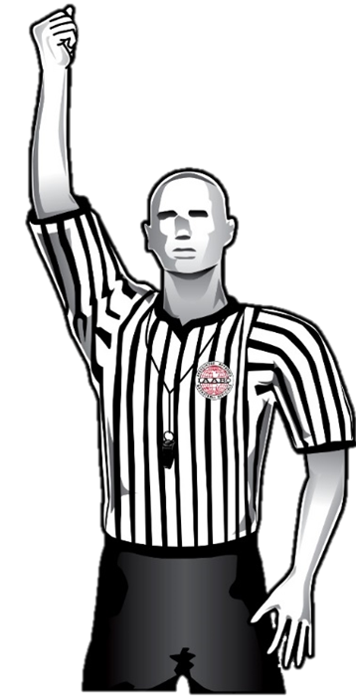
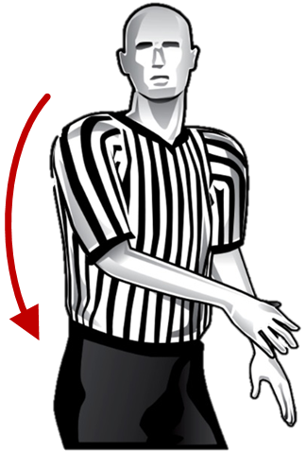
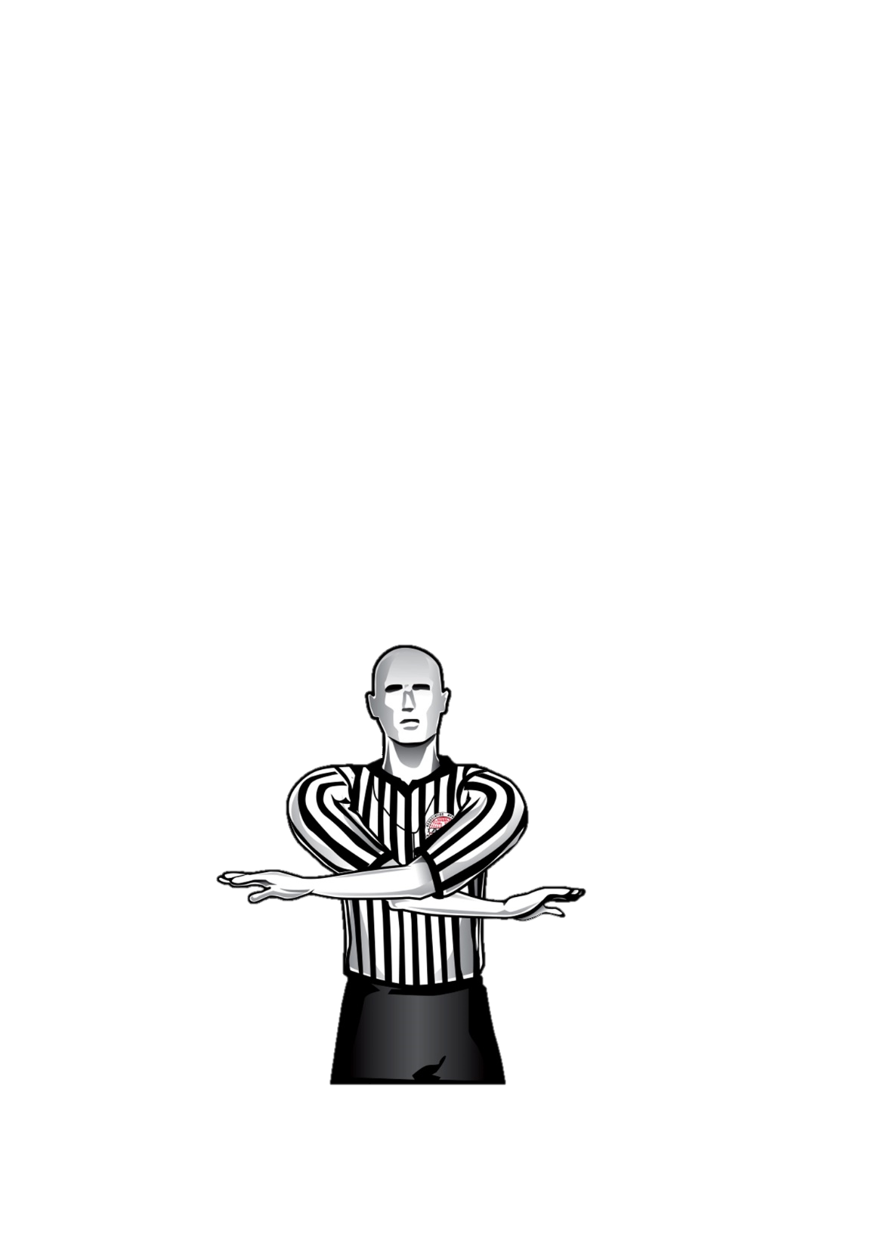
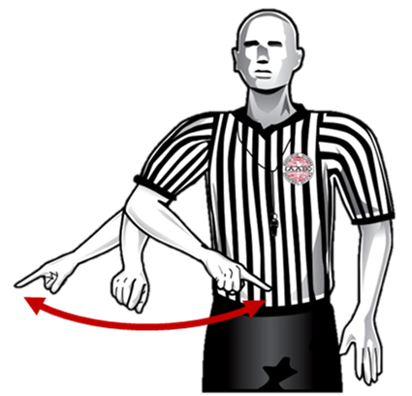
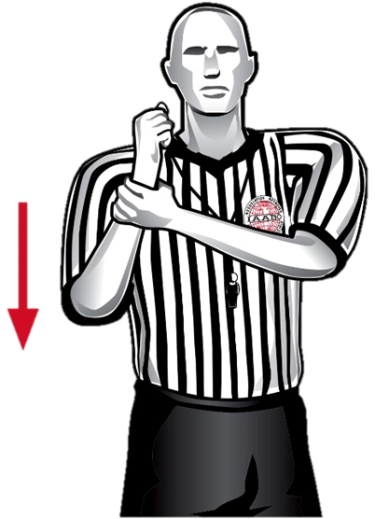
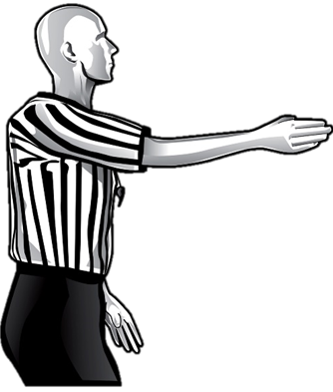
Site-of-Foul Procedure (no free throws)
❶
❷
❸
❹
White, 32
Continue
holding the
foul signal and step toward
the player who committed
the foul.
Stop the
clock with
a fist and blow whistle simulta-neously.
Make eye contact with partner.
Signal to count/
cancel goal,
if applicable.



Hold
Blue
Signal and state direction
(if player- or team-control foul).
Signal and state the type of foul.
Indicate
the throw-in spot.
IAABO Manual 13:1

Slide 34
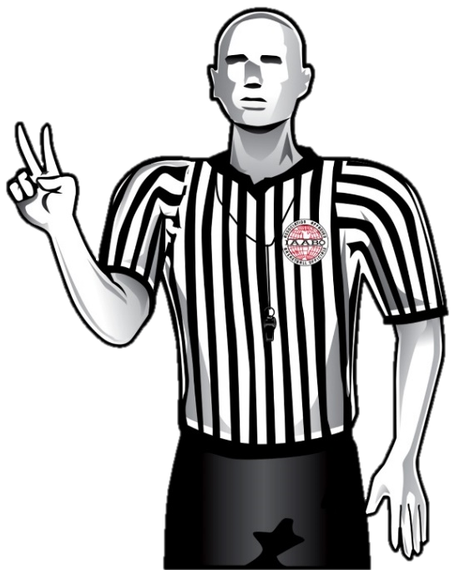
Site-of-Foul Procedure (with free throws)
❶
❷
❸
Stop the clock with a fist and blow whistle simultaneously.
Make eye
contact with partner.
Signal to count/cancel goal, if applicable.
❹
White, 32

Hold

Blue, 14.
Two shots
State the jersey color
and number of the
player who was
fouled, and then
signal and state the number of free throws.
Continue holding
the foul signal
and step toward
the player who committed the foul.
Signal and state the type of foul.
IAABO Manual 13:1

Slide 35
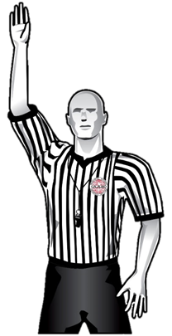
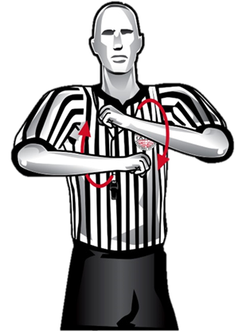
SITE-OF-VIOLATION PROCEDURE
❶
❷
❸
Stop the clock and blow whistle simultaneously.
Make eye
contact with partner.
Signal the type
of violation.
❹


*Blue
If possible, the official should use the same arm to stop the clock, signal direction and indicate the ensuing throw-in spot.
If not, ensure all signals are independent of one another.
Indicate the
throw-in
spot.
Signal direction.
*If ruling an OOB violation, also state jersey color of the team entitled to the ball.
IAABO Manual 11:1

Slide 36
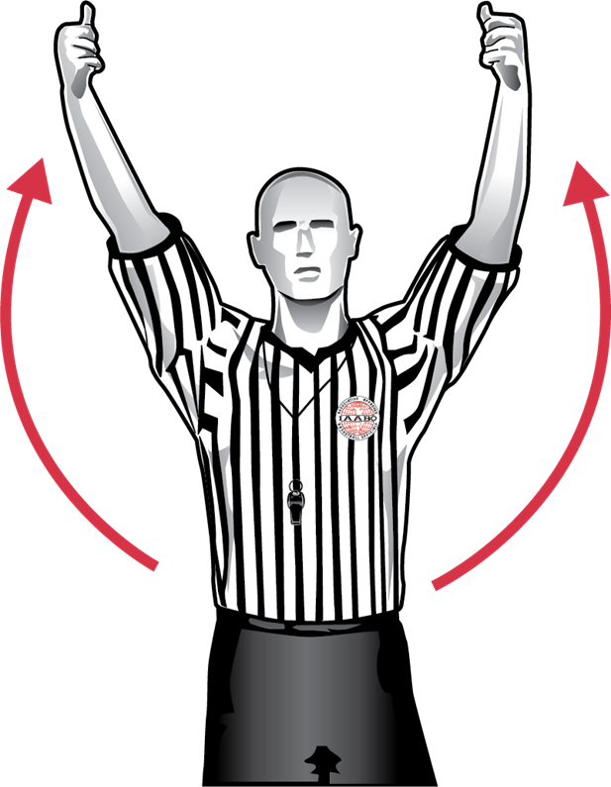
Held-ball procedure
❶
❷
❸
The official closest to the play should take a couple of steps toward the players.
*** If it appears that an altercation could occur, the official should react quickly and attempt to get between the players.
Stop the clock and blow whistle simultaneously.
Signal a held ball.
❹

After play is stopped:
The official facing the table checks the arrow and signals the direction of the team entitled to the alternating-possession arrow.
The official facing away from the table continues to monitor players.
The non-ruling official(s) should remain back, freeze their eyes on the other players and be prepared to monitor the bench areas.
IAABO Manual 8:1

Slide 37
WRAP-UP

Slide 38
WRAP-UP
As we conclude this year’s edition of the You Make the Ruling presentation, we encourage every official to carry forward the habits of accuracy, consistency, and professionalism highlighted throughout this material.
The clips we’ve shared are more than just examples—they are opportunities to sharpen judgment, refine floor mechanics, and strengthen our shared commitment to the game.

Slide 39
WRAP-UP
Thank you to all who have engaged with this material and continue to invest in educating officials across the country. By studying plays, discussing interpretations, and modeling the approved signals and floor mechanics, we elevate the standard for every contest we work.
Let’s take what we’ve learned here and bring it to life on the court this season—because every ruling we make is an opportunity to get it right, to set the tone, and to represent our profession with pride.

