Slide 1
2025-26 YMTR – Plays 19-21: Offense-initiated contact
TJ Halliday – Director of Learning and Development, IAABO, Inc.
Notes:
Lesson 1

Slide 2
2025-26 YMTR
Welcome to the 2025-26 basketball season. On behalf of Donnie Eppley, Executive Director of IAABO, the International Association of Approved Basketball Officials.
It is our pleasure to highlight areas that need attention as we approach the new season. These areas include:
Block/charge
Traveling
Contact on ball handlers
Offense-initiated contact
Post play
Rebounding contact
Screening
Violations

Slide 3
2025-26 YMTR
We will comment on proper signaling and floor mechanics as each play is reviewed, in addition to discussing the application of the rules. We are asking all officials to commit to utilizing accurate signals when making rulings in their games. Let’s remember where we are each night when we enter the court. If we are officiating a high school game, then we should use the approved high school signals and floor mechanics and set an example for all high school officials to follow. These signals and floor mechanics are listed in the officials’ manual, along with the procedures for ruling fouls, violations, time-outs, etc.

Slide 4
2025-26 YMTR
See if you can make correct rulings on these plays. This presentation is designed to create lively discussions and assist in officiating these plays correctly. We would like to thank the officials shown in these clips as they are providing a great service in teaching these concepts to our members. Many thanks also to President Don Thorne and the IAABO Executive Committee for making this presentation possible.

Slide 5
SUPPORT
If you should have any questions, comments, feedback about this material, please contact TJ Halliday at tjhalliday@iaabo.org.

Slide 6
FORMAT
This presentation is created to create an interactive session either in person or in an online session like Zoom, Teams, Google Meet, etc.
Each play begins with a question posed to the audience to prepare them for the situation they will encounter.
The audience will be shown a video clip.
The facilitator with then lead the group in discussion about the ruling and attempt to arrive at a consensus for the correct ruling.
Once the audience determines their answer, we will provide the official answer along with a play summary that outlines the specific rules and manual information that applies to each situation.

Slide 7
FORMAT
There are a handful of “You Make Ruling” plays where IAABO does not provide an official answer. We still provide a play summary for the facilitator to address the rules, floor mechanics, procedures and signals that apply.
**** This year, all 40 of the clips feature Crew of 2 floor mechanics.

Slide 8
PLAYS
Plays 1-5 Block/Charge
Plays 6-10 Pivot Foot
Plays 11-14 Contact on the Shooter
Plays 15-18 Contact on the Ball Handler
Plays 19-21 Offense-Initiated Contact
Plays 22-24 Screening
Plays 25-27 Rebounding
Plays 28-30 Off-Ball/Post Play
Plays 31-37 Other Violations and Held Ball
Plays 38-40 Other
Appendix Site of Foul/Violation Procedures

Slide 9
OFFENSE INITIATED CONTACT

Slide 10
PLAY #19

Slide 11
PLAY # 19
Does the offensive player commit a player-control foul on this play?
  Yes
  No

Slide 12
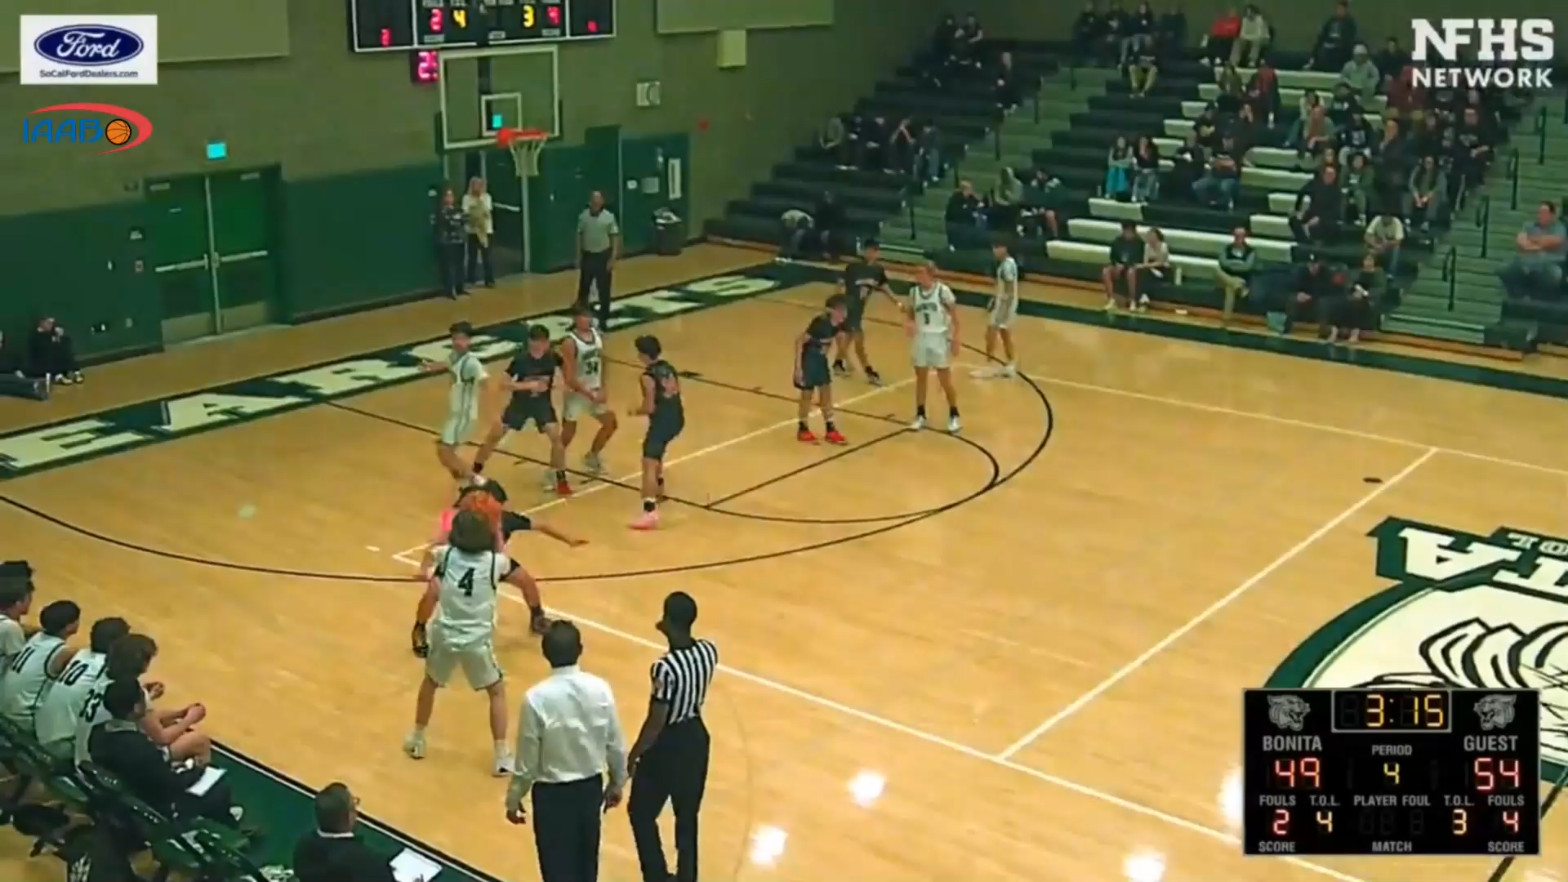
LOW POST “BACKDOWN”?

Slide 13
PLAY # 19
Does the offensive player commit a player-control foul on this play?
  Yes
  No

Slide 14
PLAY # 19
Does the offensive player commit a player-control foul on this play?
  Yes
  No

Slide 15
PLAY SUMMARY
There is not a significant amount of contact on the play. But if the defender was displaced, it is a foul.
Offensive players often want to get closer to the basket before attempting a try. There are legal ways to move closer through what the rules refer to as “cleverness and skill.”
Offensive players should not be permitted to “create space” to perform their offensive movements by illegally contacting their defenders.
IAABO Rules Guide 11:2 NFHS 10-7-7, 10-7-10

Slide 16
PLAY #20

Slide 17
PLAY # 20
Does the offensive player commit a player-control foul on this play?
  Yes
  No

Slide 18
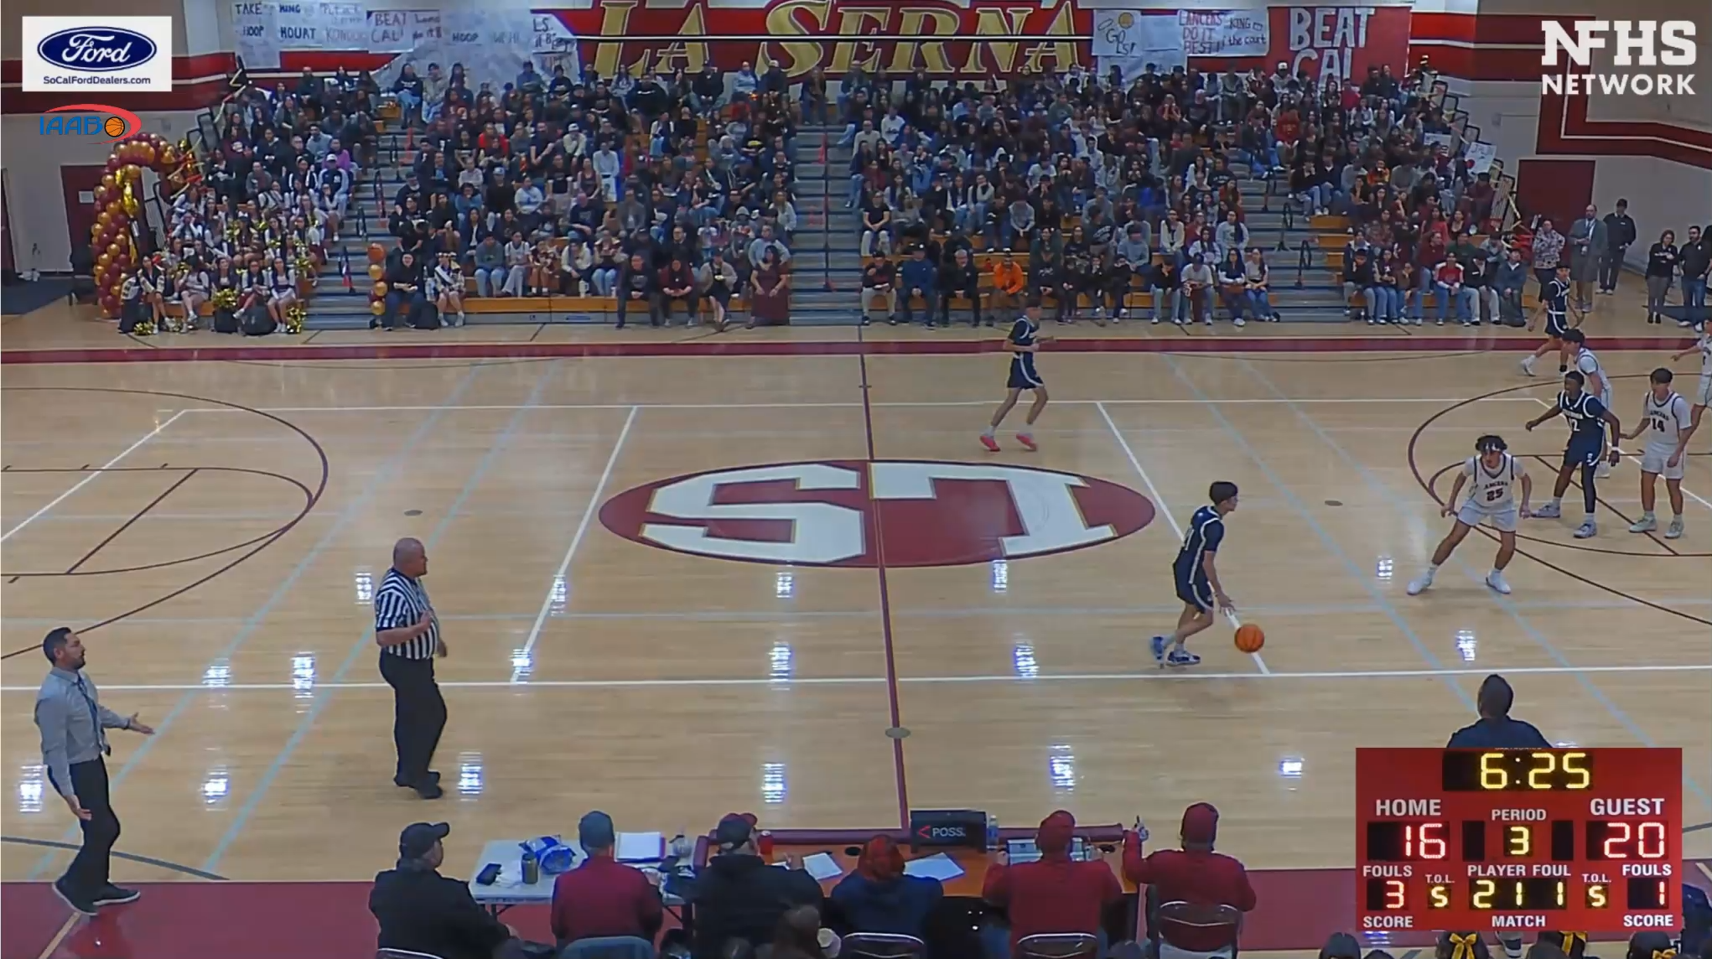
DRIBBLER PUSH-OFF?

Slide 19
PLAY # 20
Does the offensive player commit a player-control foul on this play?
  Yes
  No

Slide 20
PLAY # 20
Does the offensive player commit a player-control foul on this play?
  Yes
  No

Slide 21
PLAY SUMMARY
A player shall not use the hands on an opponent in any way that inhibits the freedom of movement or acts in an aid to player starting or stopping.
Offensive players should not be permitted to “create space” to perform their offensive movements by illegally contacting their defenders.
If these tactics displace the defender, there is rules support for charging a player-control foul.
IAABO Rules Guide 11:2:B.2, 11:4:A, NFHS 4-19-6, 10-7-3

Slide 22
PLAY #21

Slide 23
PLAY # 21
Does the offensive player commit a player-control foul on this play?
  Yes
  No

Slide 24
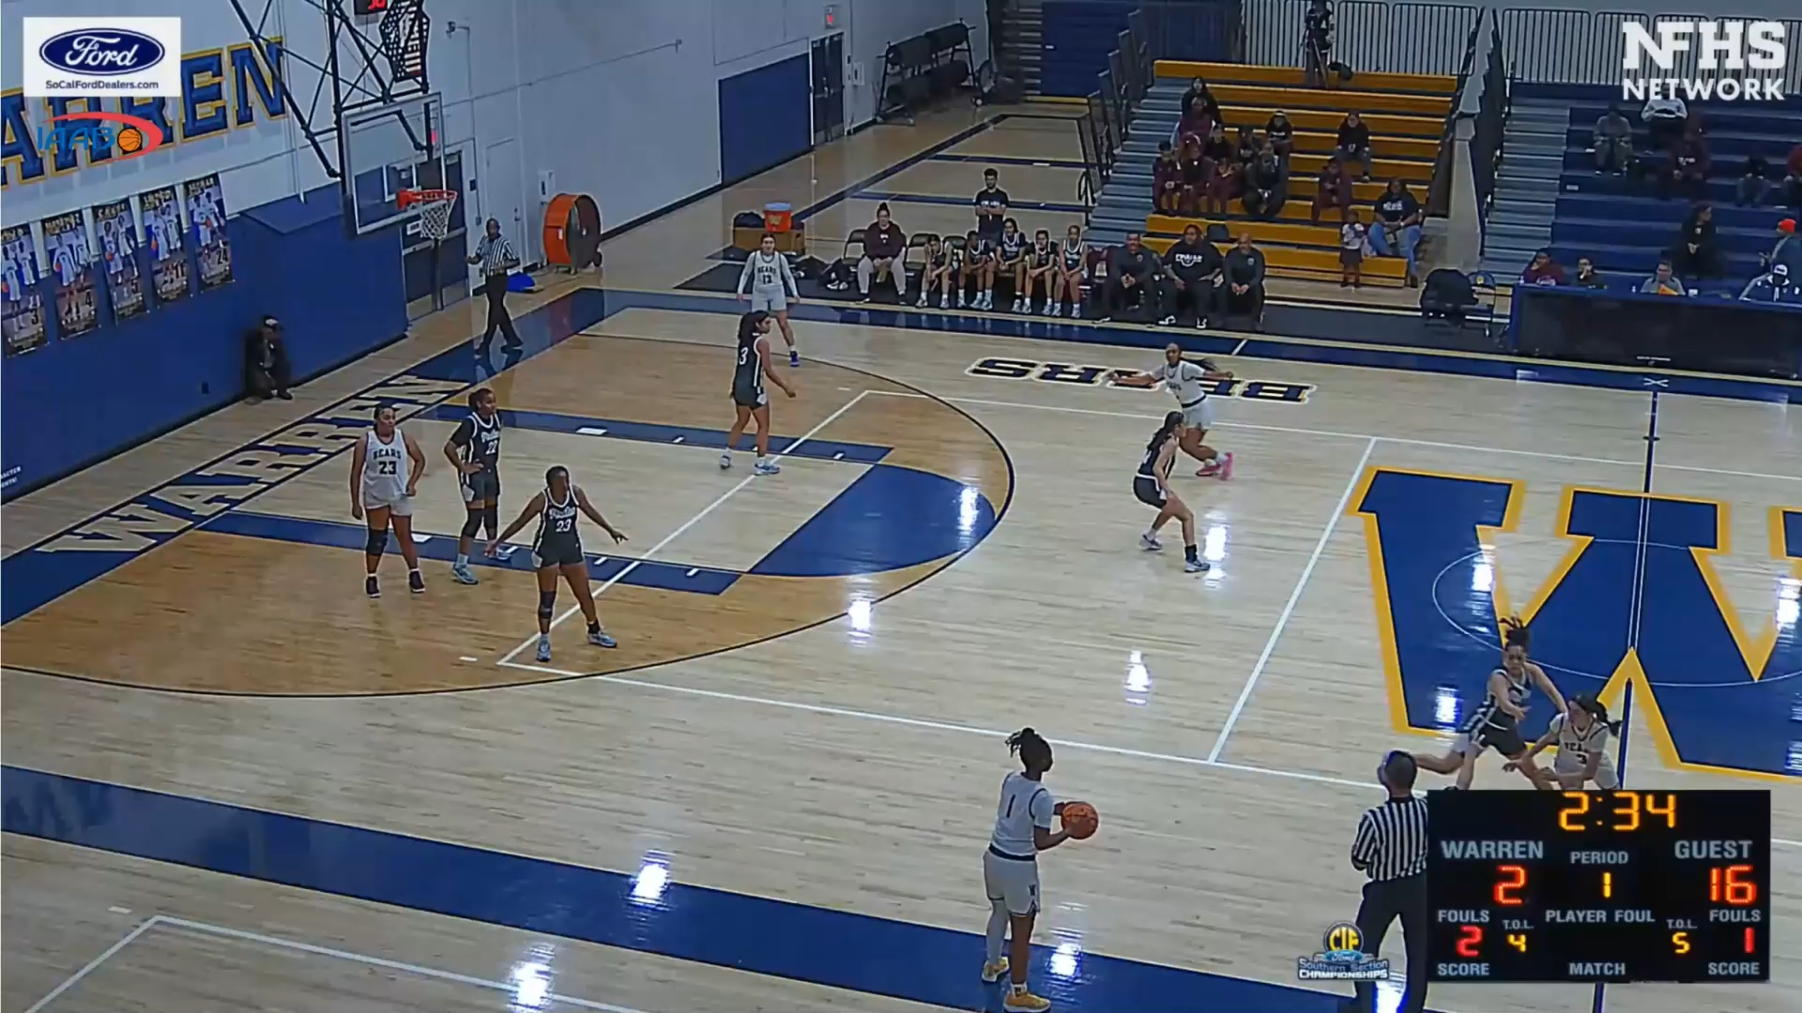
BALL HANDLER PUSH OFF?

Slide 25
PLAY # 21
Does the offensive player commit a player-control foul on this play?
  Yes
  No

Slide 26
PLAY # 21
Does the offensive player commit a player-control foul on this play?
  Yes
  No

Slide 27
PLAY SUMMARY
In this play we see a player who has picked up their dribble and is facing intense defense. It is not unusual to see offensive players attempt to create some space to get a better view of the court so they can pass the ball to a teammate.
Offensive players should not be permitted to “create space” to perform their offensive movements by illegally contacting their defenders.
If these tactics displace the defender, there is rules support for charging a player-control foul.
IAABO Rules Guide 11:2:B.2, 11:4:A, NFHS 4-19-6, 10-7-3

Slide 28
SITE-OF-FOUL,
Site of-VIOLATION,
and HELD-BALL PROCEDURES

Slide 29
SITE-OF-FOUL, Site of-VIOLATION, and HELD-BALL PROCEDURES
Many of the plays seen in this video do not feature proper site procedures.
This section can be utilized by clinicians to educate officials what the proper procedures should look like when executed properly.

Slide 30
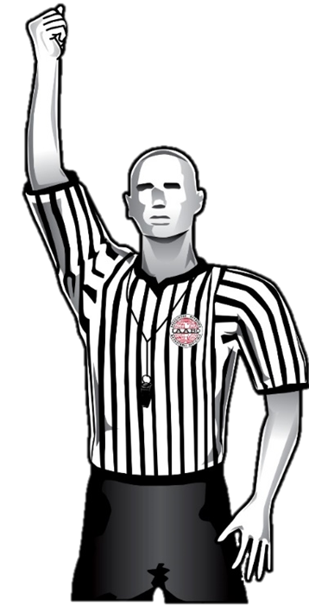
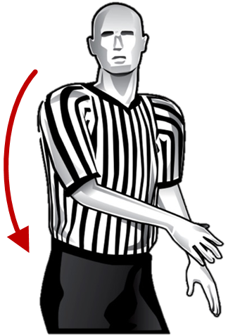
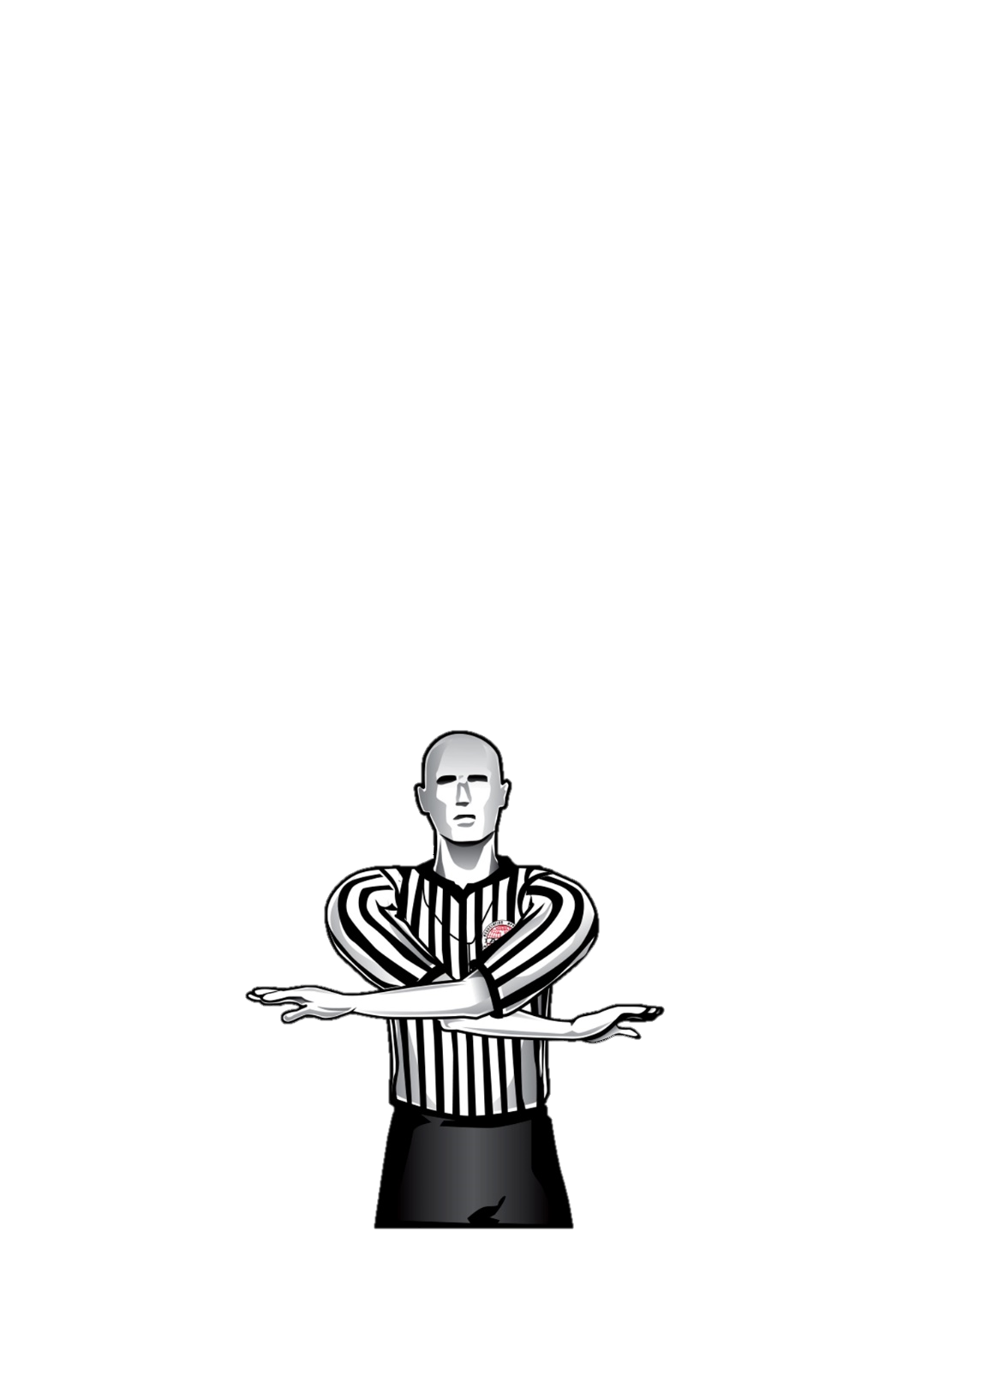
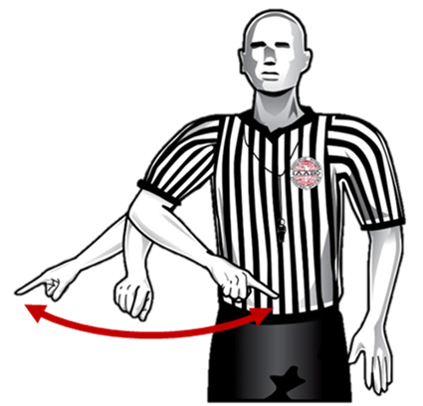
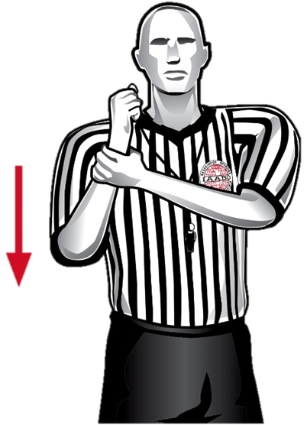
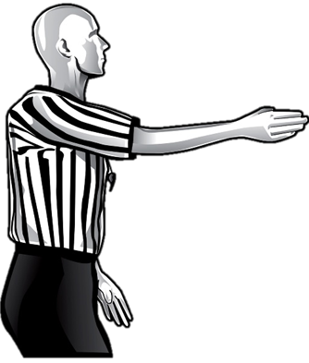
Site-of-Foul Procedure (no free throws)
❶
❷
❸
❹
White, 32
Continue
holding the
foul signal and step toward
the player who committed
the foul.
Stop the
clock with
a fist and blow whistle simulta-neously.
Make eye contact with partner.
Signal to count/
cancel goal,
if applicable.



Hold
Blue
Signal and state direction
(if player- or team-control foul).
Signal and state the type of foul.
Indicate
the throw-in spot.
IAABO Manual 13:1

Slide 31
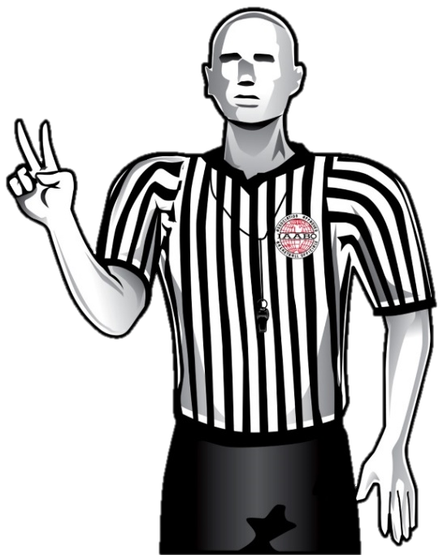
Site-of-Foul Procedure (with free throws)
❶
❷
❸
Stop the clock with a fist and blow whistle simultaneously.
Make eye
contact with partner.
Signal to count/cancel goal, if applicable.
❹
White, 32

Hold

Blue, 14.
Two shots
State the jersey color
and number of the
player who was
fouled, and then
signal and state the number of free throws.
Continue holding
the foul signal
and step toward
the player who committed the foul.
Signal and state the type of foul.
IAABO Manual 13:1

Slide 32
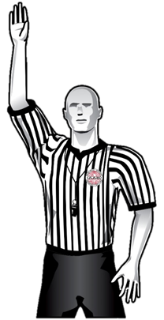
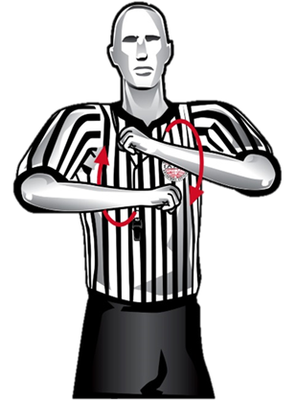
SITE-OF-VIOLATION PROCEDURE
❶
❷
❸
Stop the clock and blow whistle simultaneously.
Make eye
contact with partner.
Signal the type
of violation.
❹


*Blue
If possible, the official should use the same arm to stop the clock, signal direction and indicate the ensuing throw-in spot.
If not, ensure all signals are independent of one another.
Indicate the
throw-in
spot.
Signal direction.
*If ruling an OOB violation, also state jersey color of the team entitled to the ball.
IAABO Manual 11:1

Slide 33
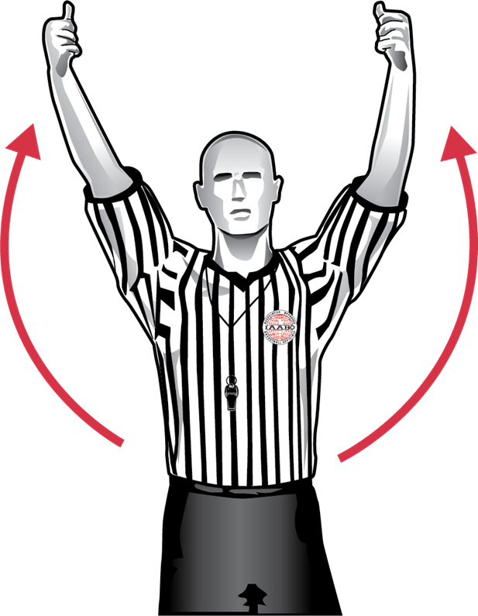
Held-ball procedure
❶
❷
❸
The official closest to the play should take a couple of steps toward the players.
*** If it appears that an altercation could occur, the official should react quickly and attempt to get between the players.
Stop the clock and blow whistle simultaneously.
Signal a held ball.
❹

After play is stopped:
The official facing the table checks the arrow and signals the direction of the team entitled to the alternating-possession arrow.
The official facing away from the table continues to monitor players.
The non-ruling official(s) should remain back, freeze their eyes on the other players and be prepared to monitor the bench areas.
IAABO Manual 8:1

Slide 34
WRAP-UP

Slide 35
WRAP-UP
As we conclude this year’s edition of the You Make the Ruling presentation, we encourage every official to carry forward the habits of accuracy, consistency, and professionalism highlighted throughout this material.
The clips we’ve shared are more than just examples—they are opportunities to sharpen judgment, refine floor mechanics, and strengthen our shared commitment to the game.

Slide 36
WRAP-UP
Thank you to all who have engaged with this material and continue to invest in educating officials across the country. By studying plays, discussing interpretations, and modeling the approved signals and floor mechanics, we elevate the standard for every contest we work.
Let’s take what we’ve learned here and bring it to life on the court this season—because every ruling we make is an opportunity to get it right, to set the tone, and to represent our profession with pride.

